Slide 1

FACULTY OF INFORMATION TECHNOLOGY
Flutter Medicine Tracker app

Slide 2
Presented by:
Supervised by: Dr. Alaa Zaghloul
Mark Emad | Seif Hany | Youssef Khaled | Yossef Mohamed
89603 | 89568 | 94246 | 89551

Slide 3

Agenda
Introduction
Possible Beneficiaries
Motivation
Main Objectives
SDG’s Goal
Related Works
Problem Definition
Proposed System
System Architecture
Methodologies and Techniques
System Requirements (S/W and H/W Tools)
Results and Outcomes
System Validation
Conclusion
References

Slide 4
Introduction

Slide 5
What is our application about and what does it offer?
We designed a medicine reminder application that fulfills everyone’s medication needs in one place: pill reminders, support for any dosage form (incl. tablet, pill, inhalation, injection), frequency, and even refill reminders.
Our application isn’t made for patients and sick people only, nurses could also use our application to keep track of the patients they are taking care of.
In fact, anyone can use our application; whether it’s a patient, a nurse, or a family member. We are designing the application with the intention of making it accessible and user-friendly.
Our main goal is to keep the application as accessible and straightforward as possible.

Slide 6

Possible Beneficiaries
Patients
Caregivers
Healthcare Providers

Slide 7

Motivation
Why use our application
Motivation

Slide 8
Main Objectives
Our objective is to design an application that will:
Remind patients to take their medications on time.
Remind patients to refill their medications before they run out.
Remind patients the dose for each medicine.
Send SOS emergency alerts to family members.
Provide means to carry around a handwritten medication memo at all times.
Store medicine and its information in a database, if a user uses the same medicine more than one time.

Slide 9




Sustainable Development Goals (SDG’s)
Good Health and Well - Being
Industry, Innovation, and Infrastructure
Sustainable Cities and Communities
Responsible Consumption and Production

Slide 10
Related Work
MedsLog
Medhelper
Dosecast
Mango Health
Pros | Cons | Feature
Medicine Reminder | Bad Interface Costly | NO Unique Feature
Friendly Interface Take Notes | Needs Internet connection | Database stores information about each medicine
Friendly Interface Customize Ringtone | Costly Needs internet connection | Multiple Devices
Friendly Interface | Needs Internet connection | Healthy Activity

Slide 11
Related Work
Pros | Cons | Feature
Friendly Interface | Needs Internet Connection | Virtual Assistant
Friendly Interface Customize Ringtone | Needs Internet Connection | Link With Specific Doctor
Friendly Interface | Needs Internet Connection | Group Sharing
EveryDose
MyTherapy Pill Reminder
Medisafe Pill & Med Reminder

Slide 12
Problem Definition
What problems people face without the application?
How does the project solve this problem?
What tools does the application offer to help?

Slide 13
Proposed System
What new features does our medicine reminder app adds compared to existing applications?

Slide 14
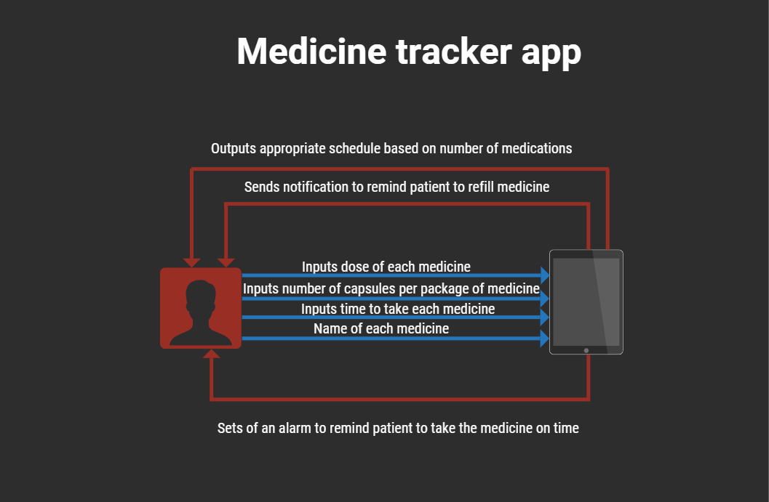
System Architecture

Slide 15
Methodologies and Techniques
Agile Software Development Methodology anticipates the need for flexibility and applies a level of efficiency to the delivery of the finished product. Agile software development focuses on the clean delivery of individual pieces or parts of the software and not on the entire application.
Rapid Application Development (RAD) / Rapid Application Building (RAB), is an agile software development approach that focuses more on ongoing software projects and user feedback and less on following a strict plan. As such, it emphasizes rapid prototyping over costly planning. RAD is the best approach to develop prototypes swiftly for testing software functionalities without worrying about any effects on the end product, enabling the team to design, review, and iterate features and functionalities quickly.

Slide 16





System Requirements (S/W and H/W Tools)
Software
Hardware
Processor: intel core i7 11th generation
Ram: 16 GigaByte (GB)
Hard-Disk: 1 TeraByte (TB)
Any android device that can run android application is a suitable hardware for the Medicine Tracker project

Slide 17
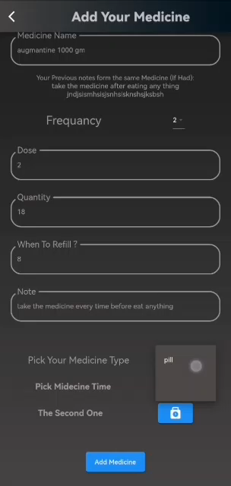
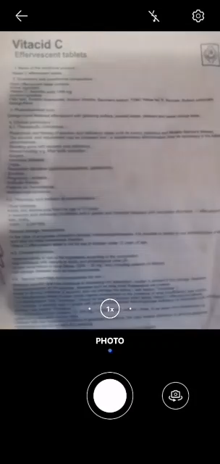
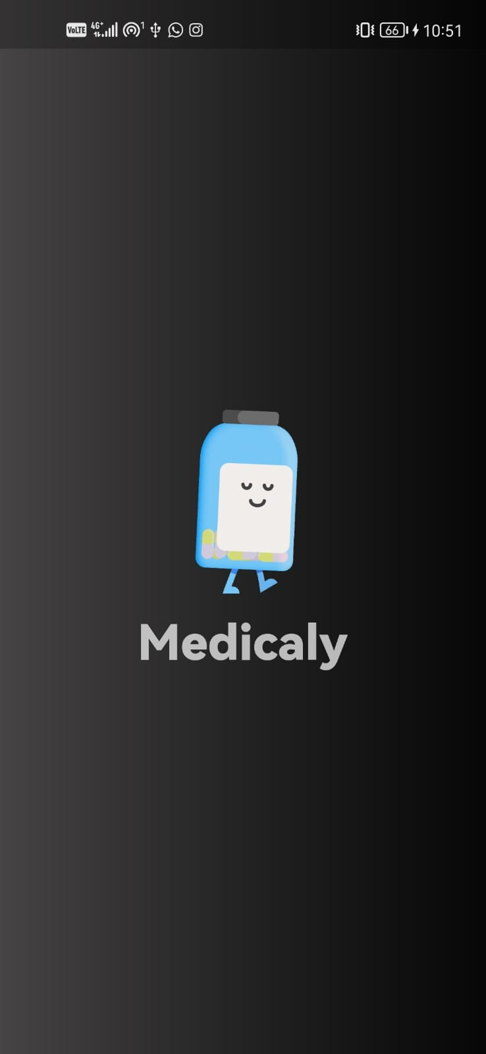

Results and Outcomes

Slide 18
System Validation
Requirements Verification
Functional Testing
Usability Testing
Performance Testing
User Acceptance Testing
The medicine tracker mobile application has successfully passed the system validation with positive results.

Slide 19
Conclusion
Why is this app needed?
How can it save you from a lot of trouble?

Slide 20
References
MEDHELPER INC. BY MONTREAL BASED HEALTHCARE TECHNOLOGY START-UP
MEDSLOG BY MODESITT SOFTWARE
DOSECAST BY MONTUNO SOFTWARE, LLC 4.
CUTE PILL BY FUTASAJI LCC 6. EVERYDOSE BY GROOVE HEALTH INC
MEDISAFE BY TRUEPILL
MANGO HEALTH BY TRIALCARD

Slide 21


